Slide 1
CTF model for long reverberation Date：2022. 07. 26
Telecom Electroacoustics Audio(TEA) Lab
Presenter:
Anchi Yuan
Notes:
Hello everyone
I’m today’s presenter siang. I’m going to share some of my present work in source separation problem. My topic is comparative studies of source separation using semi-blind and blind source separation approaches.

Slide 2
Outline
Modified method for ATF prediction
Simulation setting
Simulation result
Future work

Slide 3
Modified method for ATF prediction
expect that lasso can increase sparsity of prediction source

Slide 4
Modified method for ATF prediction
Next, use MINT to compute s.

Slide 5
Algorithm summary
De-reverberation using WPE.
Estimate the dry source signal s^ using DAS.
Estimate the ATF a using
Wiener filter
Adaptive filters: LMS, RLS, and Kalman filter
Refine the source signal by MINT

Slide 6
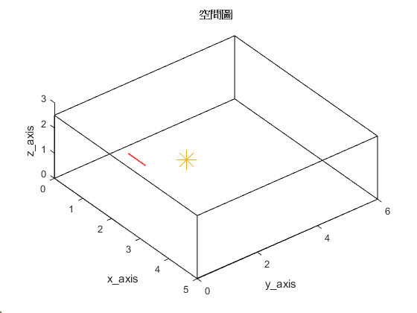
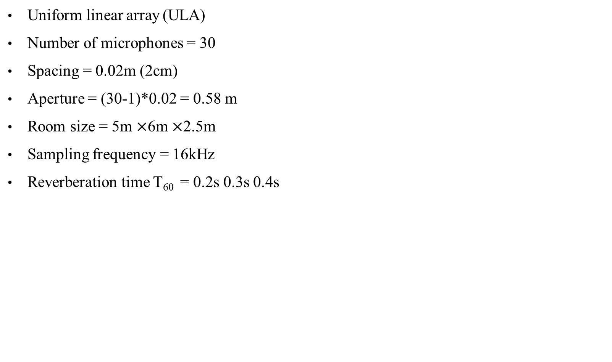
Simulation setting
Uniform linear array (ULA)
Number of microphones = 30
Spacing = 0.02m (2cm)
Aperture = (30-1)*0.02 = 0.58 m
Room size = 5m $×$6m $×$2.5m
Sampling frequency = 16kHz
Reverberation time T₆₀ = 0.2s 0.3s 0.4s
First microphone location [1, 1.5, 1]
2.5m
origin
Source location [2, 2.6, 1]
5m
6m

Slide 7
Simulation result(1)
T₆₀ = 0.2s
Square error = 0.000611
Square error = 0.000637
Ground-truth RIR
Initialize with WPE and DAS
final estimated ATF

Slide 8
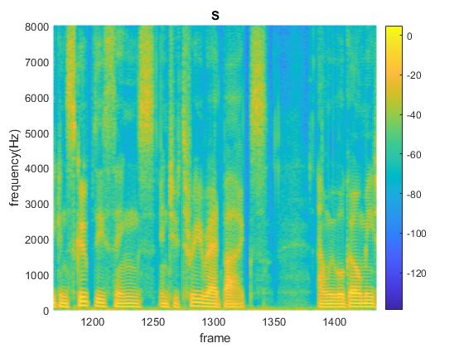
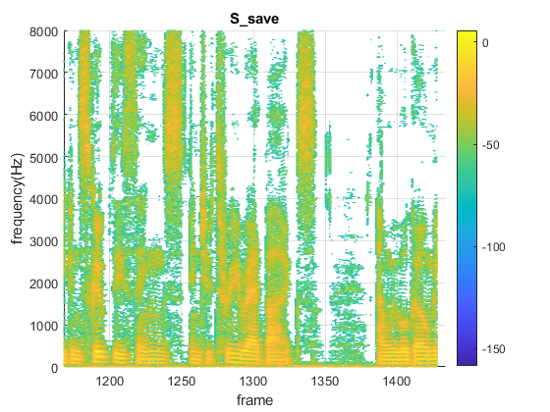

Simulation result(2)
T₆₀ = 0.2s
Ground-truth source spectrom
Predicted source spectrom
Ground-truth source | Microphone reveived | Predicted source

Slide 9
Simulation result(3)
T₆₀ = 0.3s
Square error = 0.0024
Square error = 0.0024
Ground-truth RIR
Initialize with WPE and DAS
final estimated ATF

Slide 10
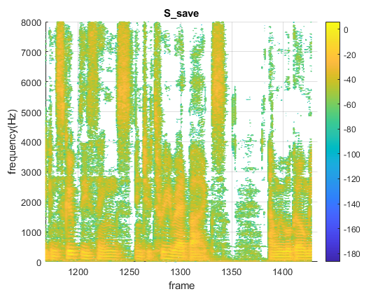
Simulation result(4)
T₆₀ = 0.3s
Ground-truth source spectrom
Predicted source spectrom
Ground-truth source | Microphone reveived | Predicted source

Slide 11
Simulation result(5)
T₆₀ = 0.4s
Square error = 0.0063
Square error = 0.0064
Ground-truth RIR
Initialize with WPE and DAS
final estimated ATF

Slide 12
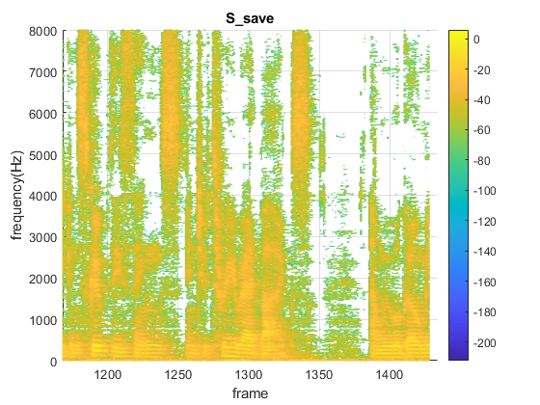
Simulation result(6)
T₆₀ = 0.4s
Ground-truth source spectrom
Predicted source spectrom
Ground-truth source | Microphone reveived | Predicted source

Slide 13
Future work
CTF with Kalman filtering

Slide 14


